Slide 1


OLIST E-COMMERCE
ANALYTICS
Power BI Capstone Project
Turning multi-table Brazilian e-commerce data into an interactive decision-support dashboard.
ORDERS
ITEM-PRICE GMV
99,441
$ 13.59M
UNIQUE CUSTOMERS
96,096
1
Dataset: Brazilian E-Commerce Public Dataset by Olist • Analysis period: 2016–2018

Slide 2
Business Context and Scope of Dataset
2
About Olist
Business questions
• Brazilian retail technology and marketplace ecosystem.
• Public dataset reflects roughly 100k orders from 2016–2018.
• Data spans orders, products, customers, sellers, payments, reviews and geography.
• This project is a historical analytics case study — not current Olist company performance.
Commercial performance
How much value is generated?
Portfolio mix
Which categories drive GMV?
Customer experience
Where are low reviews concentrated?
Fulfillment
How successfully are orders delivered?
Geography
Which states drive demand and where is delivery slower?

Slide 3
Data Landscape & Data Types
3
Eight source tables form the analytical base
Table
Rows × Columns
Business role / data type
Orders
99,441 × 8
Text + Date/Time + status
Order_items
112,650 × 7
IDs + numeric price/freight
Products
32,951 × 9
Product attributes
Customers
99,441 × 5
IDs + location
Sellers
3,095 × 4
Seller + location
Payments
103,886 × 5
Payment + numeric
Reviews
99,224 × 7
Score + text + IDs
Category translation
71 × 2
Category labels
Core data types: text/category • integer counts & scores • decimals such as price/freight • date/time event fields • derived DAX measures.

Slide 4
Data Understanding & Analytical Scope
4
What is being measured, and what is intentionally not measured
ITEM-PRICE GMV
AVERAGE ORDER VALUE
AVERAGE REVIEW
AVG DELIVERY
DELIVERED
$ 13.59M
$ 136.68
4.09/5
12.56 days
97.02%
What the model is good at
Important interpretation boundary
• Trend analysis by purchase date
• Category / product performance
• Customer and review analysis
• Payment mix
• Delivery and order-status analysis
• GMV here is based on item price in order_items
• Not net profit or margin
• Historical snapshot; not live business KPIs
• Business recommendations are analytical, not Olist policy

Slide 5
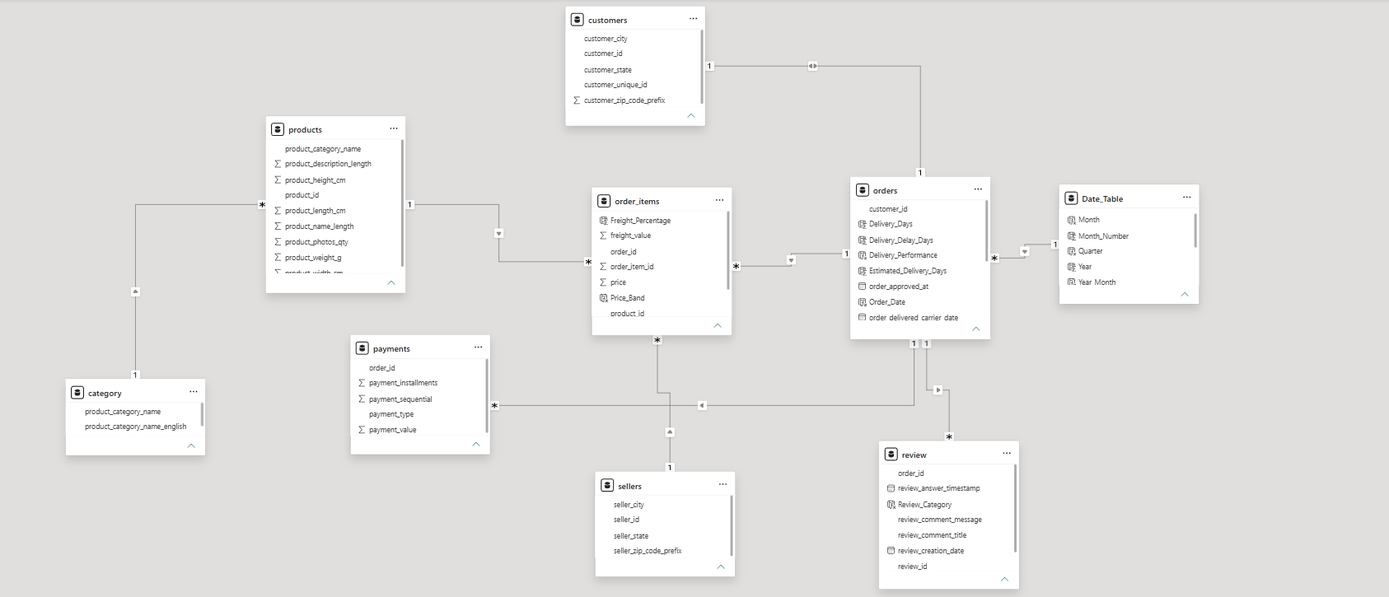
Schema / Data Model
5
Central transaction table + analytical dimensions + supporting parameter tables
Model logic: Order lifecycle sits at the center; Order items bridge products and sellers; Customers, Payments and Reviews enrich the transaction; Date and Parameter tables enable dynamic slicing.

Slide 6
Methodology
6
From raw files to a decision-support dashboard
01
02
03
04
05
06
Ingest
Profile
Model
Measure
Visualize
Interpret
Load nine CSV sources
Check data types, missingness and keys
Create relationships and supporting tables
Build DAX KPIs and selectors
Design three dashboard pages
Convert patterns into business actions
Core analytical design principle
Use measures for reusable business logic, parameters for user-driven analysis, and slicers to let management move from overview → diagnosis → action.

Slide 7
Core KPIs & DAX Logic
7
Measures turn transaction rows into management-level indicators
Measure
Logic
Why it matters
Total GMV
SUM(order_items[price])
Commercial value
Total Orders
DISTINCTCOUNT(orders[order_id])
Order volume
Unique Customers
DISTINCTCOUNT(customers[customer_unique_id])
Customer base
AOV
DIVIDE([Total GMV],[Total Orders])
Average item-price value / order
Avg Review
AVERAGE(review[review_score])
Experience signal
Cancelled Orders
CALCULATE([Total Orders], orders[order_status]="canceled")
Operational exception
Avg Delivery Days
DATEDIFF / date difference logic
Fulfillment speed
Cumulative GMV %
Cumulative GMV ÷ total GMV
Pareto prioritization

Slide 8
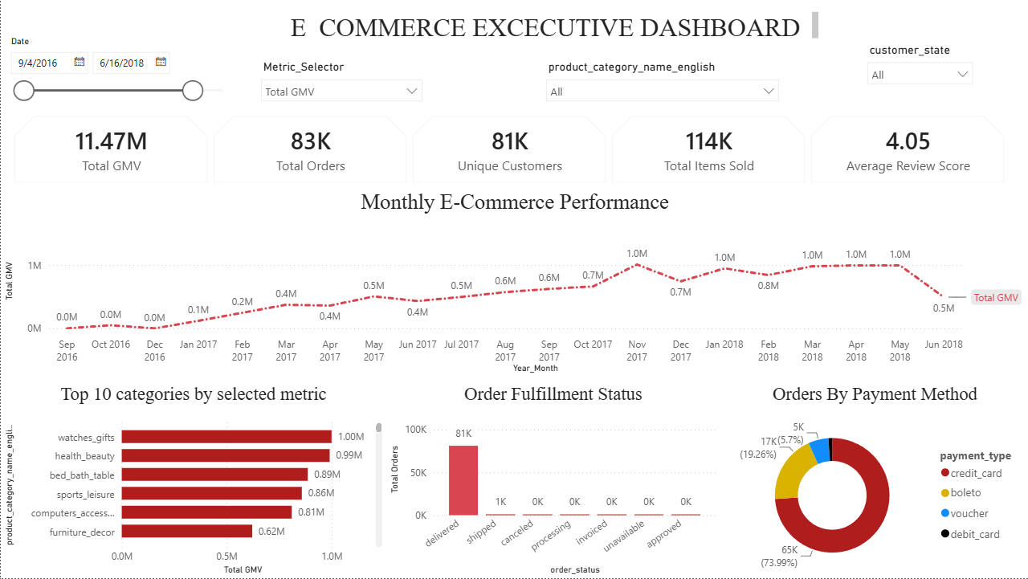
Dashboard 1 — E-Commerce Executive
8
.

Slide 9
Dashboard 1 — Visuals, Columns & Why They Were Used
9
How each component answers a decision question
KPI cards
GMV, Orders, Customers, AOV, Review
Fast executive scan
Monthly trend
purchase date + order count / selected metric
Detect peaks, dips and seasonality
Payment donut
payment_type
Understand payment dependency
Order status visual
order_status
Monitor fulfillment funnel
Slicers
date, state, category, payment
Turn the page into an exploratory tool
Metric selector
supporting parameter table
Switch the analytical lens without duplicating visuals

Slide 10
Dashboard 1 — Business Insights
10
What management can act on immediately
Scale
99,441 orders and R$13.59M of item-price GMV provide a strong transaction base.
Payment dependency
Credit cards account for 73.92% of payment records, making payment reliability strategically important.
Fulfillment success
97.02% of orders are delivered; cancellations are 625 orders (0.63%).
Experience
Average review is 4.09/5; 5-star reviews are 57.78%, while 1-star reviews are 11.51%.
Action
Track low-rating orders by category, seller, state and delivery performance to find root causes.

Slide 11
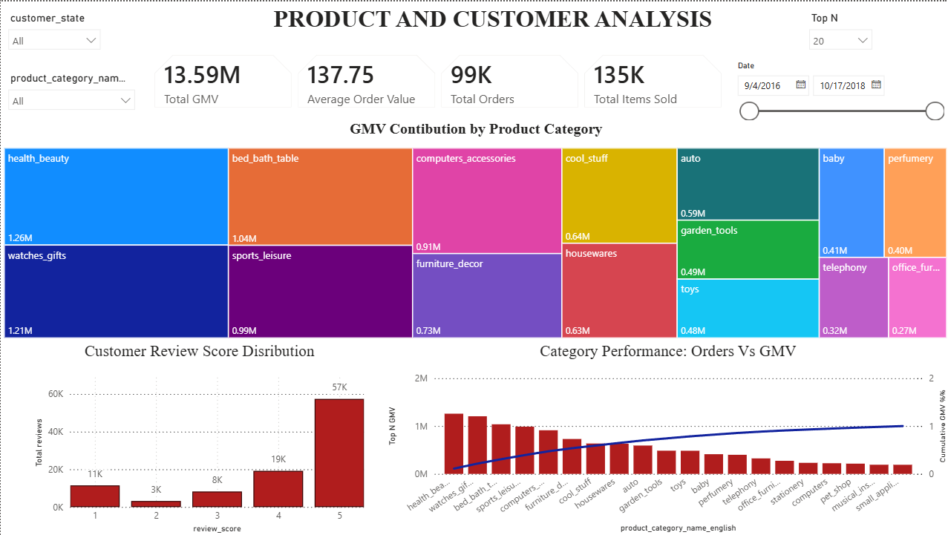
Dashboard 2 — Product & Customer Analysis
11
Portfolio concentration, Pareto prioritization and customer sentiment
.

Slide 12
Dashboard 2 — Visuals, Columns & DAX Purpose
12
Design choices that make portfolio analysis actionable
Pareto chart
category + [Total GMV] + [Cumulative GMV %]
Find value concentration / Top-N focus
Treemap
category + [Total GMV]
Compare portfolio composition at a glance
Review chart
review_score + review count/%
Measure customer sentiment distribution
Top-N parameter
Parameter table + dynamic filter logic
Let the audience set the depth of analysis
Category slicer
category
Isolate a product family
State/date slicers
customer_state + Date_Table
Find where/when performance changes

Slide 13
Dashboard 2 — Business Insights
13
Product concentration + sentiment create clear priorities
Category concentration
Top 5 categories contribute 39.7% of item-price GMV; Top 10 contribute 62.4%.
Leading category
Health & Beauty is the largest category at about R$1.26M item-price GMV.
Portfolio action
Protect high-value categories through inventory availability, merchandising and targeted promotions.
Customer sentiment
77.07% of reviews are 4–5 stars, but 1-star reviews are 11.51% — a meaningful exception pool.
Diagnostic action
Cross-filter low ratings by category, state and delivery status to identify where experience breaks down.

Slide 14
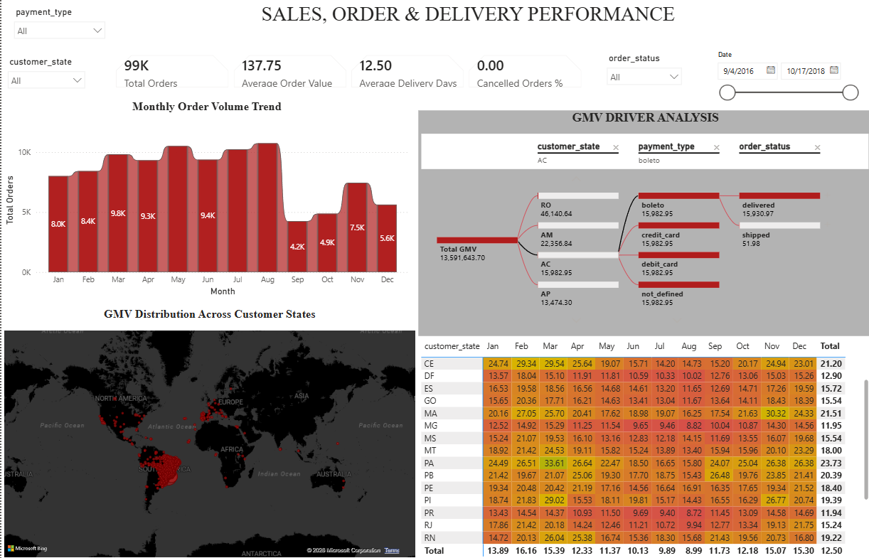
Dashboard 3 — Sales, Order & Delivery Analysis
14
Connecting commercial value with operational performance

Slide 15
Dashboard 3 — Visuals, Columns & Why They Matter
15
Operational analytics focuses on where performance changes
State analysis
customer_state + [Total GMV]
Locate demand concentration
Order status
order_status + order count/%
Monitor successful vs exception orders
Delivery KPI
purchase date + delivered date
Quantify fulfillment speed
Decomposition tree
[Total GMV] with drill dimensions
Explain what drives value
Matrix / detail view
state/category/order-status combinations
Compare operational performance across segments

Slide 16
Dashboard 3 — Business Insights
16
Geography and fulfillment reveal operational levers
Geographic concentration
São Paulo contributes about 38.3% of GMV; the top 3 states contribute 63.4%.
Delivery benchmark
Average purchase-to-delivery time is 12.56 days across delivered orders with valid dates.
Exception monitoring
625 orders are canceled; unavailable orders are another 0.61%.
Regional action
Set state-level delivery targets and investigate high-delay regions rather than using only a national average.
Commercial action
Prioritize capacity and seller/service monitoring in the states that combine high GMV with slower delivery.

Slide 17
Best Business Insights → Management Actions
17
Move from “what happened?” to “what should we do next?”
Protect the revenue core
Manage geographic concentration
Focus inventory and promotions on leading categories.
Monitor SP/RJ/MG demand and service capacity closely.
Reduce customer pain
Strengthen logistics
Analyze 1-star reviews by delivery, category and seller.
Use regional delivery targets and exception monitoring.
Keep payments resilient
Use dynamic analysis
Because credit cards dominate, payment failures can have outsized business impact.
Top-N and metric selectors make the dashboard useful for different management questions.

Slide 18
Overall Summary
This capstone project analyzed the Olist Brazilian e-commerce dataset using Power BI to convert multiple transactional datasets into an interactive business intelligence solution. The project integrated information related to orders, order items, products, customers, sellers, payments, reviews, categories into a structured analytical model.
The analysis focused on five major business areas: sales performance, product/category performance, customer behavior, payment patterns and order fulfillment and delivery. Using Power BI, DAX measures, slicers, drill-downs, dynamic parameters, KPI cards, trend charts, tree maps, Pareto analysis, decomposition trees and geographic analysis, the dashboards provide both an executive overview and detailed diagnostic insights.
The analysis indicates approximately 99,441 orders, 96,096 unique customers and $13.59 million in item-price GMV, with an overall average review score of approximately 4.09/5. The results also show that business value is concentrated in several major categories and geographic markets, while customer satisfaction and delivery performance provide important opportunities for improvement.

Slide 19
Overall Business Insights
The Project Identified Several Important Business Patterns:
1. Sales Are Concentrated Across Major Categories And Regions.
A Relatively Small Number Of Product Categories Contribute A Significant Share Of Overall GMV, Making Pareto Analysis Useful For Inventory Planning, Merchandising And Promotional Decisions.
2. Geographic Concentration Is Significant.
São Paulo Is The Largest Contributor To GMV, And The Leading States Account For A Substantial Proportion Of Overall Sales. This Suggests That Regional Demand And Logistics Should Be Monitored Separately.
3. Customer Satisfaction Is Generally Positive But Not Uniform.
Most Reviews Are In The 4–5 Star Range, But The Presence Of 1-star Reviews Highlights The Need To Identify The Major Causes Of Dissatisfaction.
4. Delivery Performance Is An Important Operational Factor.
Average Delivery Time Is Around 12.56 Days, And Regional Variation Means That A Single National Performance Indicator May Hide Specific Logistics Problems.
5. Payment Behavior Provides Useful Commercial Information.
Credit Cards Are The Dominant Payment Method, Making Payment Reliability And Customer Payment Experience Important For Maintaining Successful Transactions.
6. Interactive Analytics Improves Decision-making.
The Use Of Top-n Parameters, Metric Selectors, Slicers And Drill-down Capabilities Allows Users To Move From High-level Kpis To Detailed Category, Customer, Geographic And Operational Analysis.

Slide 20
Conclusion
The project demonstrates how Power BI can transform complex e-commerce data into actionable business intelligence. Rather than looking at sales, customer satisfaction, product performance and delivery separately, the solution connects these dimensions into a single interactive analytical framework.
The dashboards can help management identify high-performing categories, monitor sales concentration, understand customer satisfaction, evaluate payment behavior, detect delivery issues and prioritize business actions.
Overall, the project shows that effective data analytics is not only about creating attractive visualizations. Its real value comes from connecting data to business questions and converting analytical findings into practical decisions.
Final Takeaway
“The Olist Power BI project converts transactional data into a decision-support system that helps the business understand what is happening, why it is happening, and where action should be taken.”

